Slide 1


Thapar Institute Of Engineering And Technology,
Patiala.
Micro-level
Surface Crack Detection In Steel
Team:
Waris (1024170155)
Tanishq (1024170156)
Kanan (1024170164)
Samriddhi Gupta (1024170165) Group Leader
Ananya Dayal (1024170205)
Submitted To: Dr. Ritesh Sharma

Slide 2
Objective
What is Steel Crack Detection?
Deep learning delivers consistent real-time detection with superhuman accuracy, operating 24/7 without fatigue and adapting through retraining.
Where to use?
Identifying & classifying surface defects — cracks, inclusions, patches, pits — on hot-rolled steel strips using advanced image analysis and machine learning.
Surface quality impacts structural integrity in automotive, aerospace & construction. Micro-cracks under stress can cause catastrophic component failure..
Why Automated AI?

Slide 3

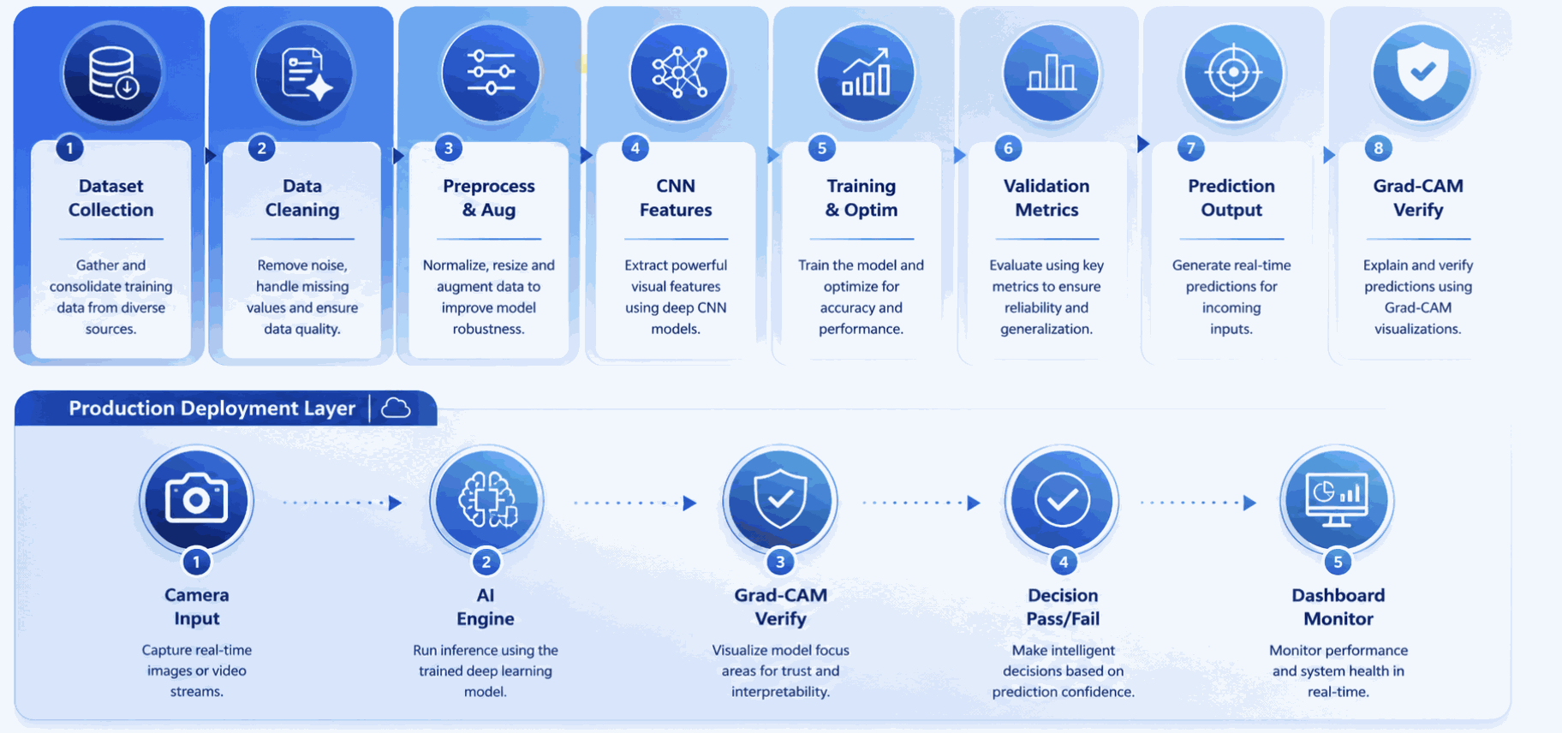
Complete AI Pipeline Architecture

Slide 4

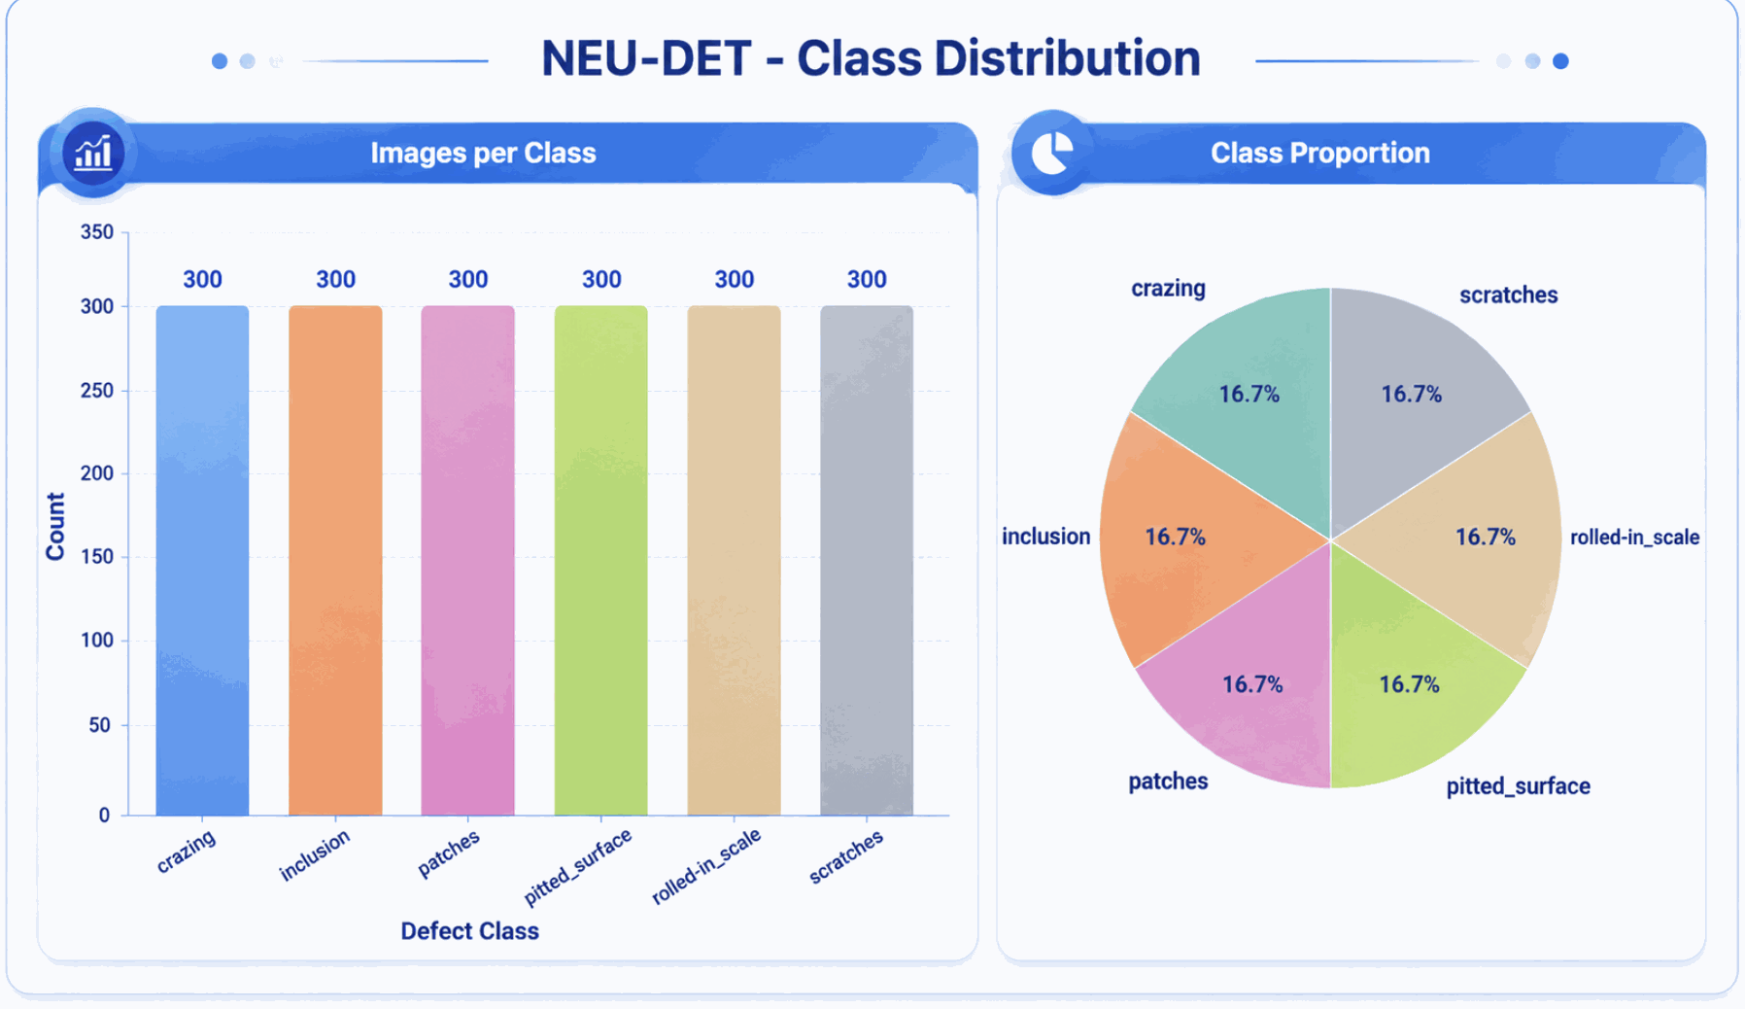
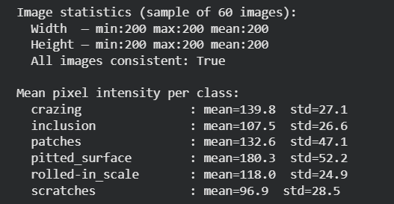
Dataset Overview

Slide 5
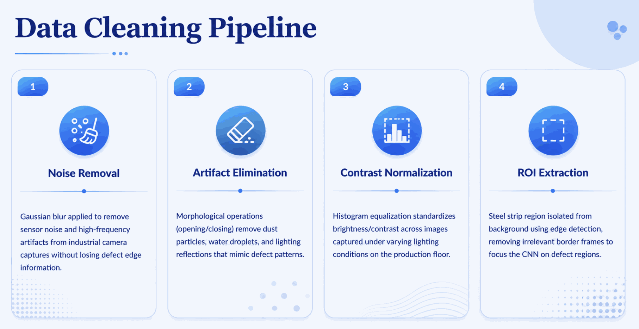

Slide 6
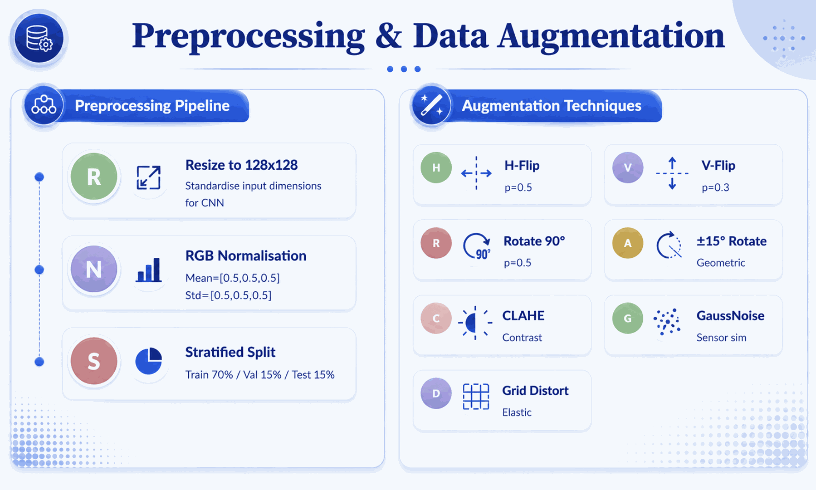

Slide 7
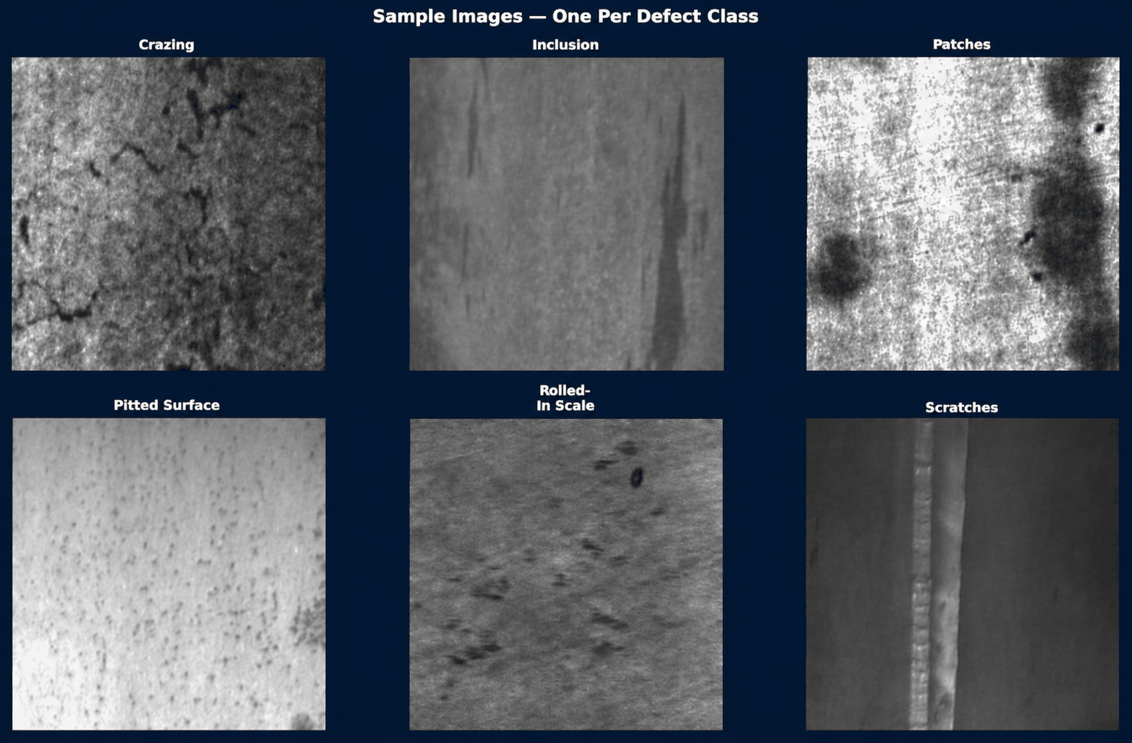

Slide 8
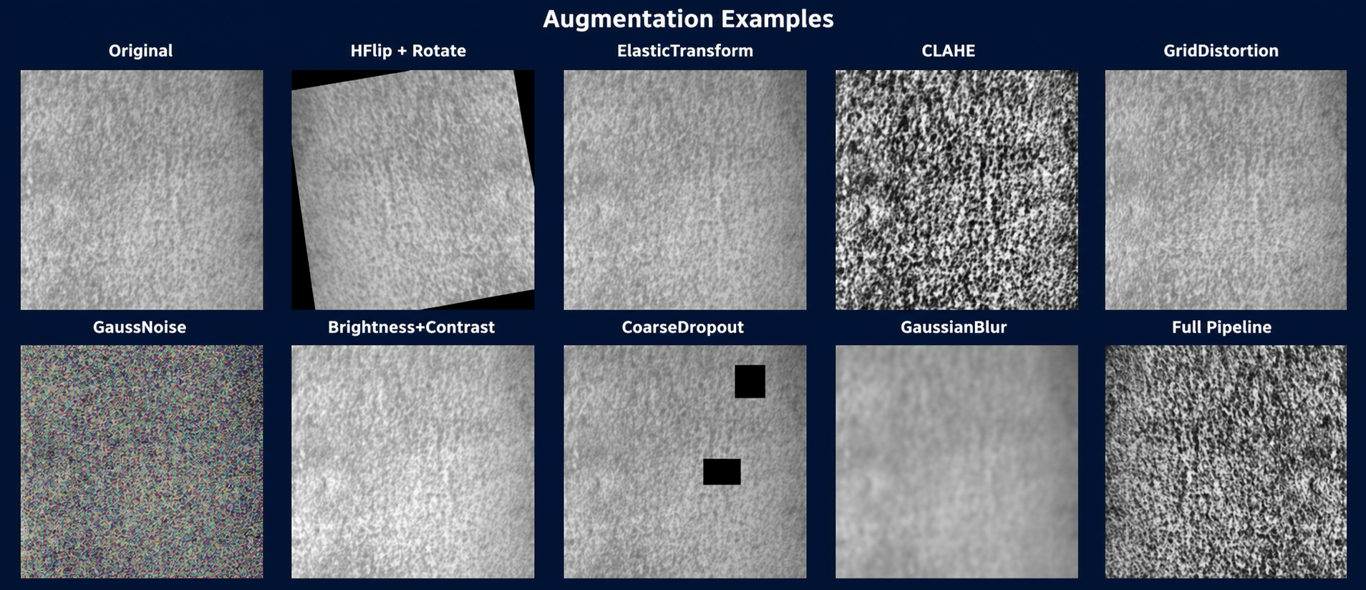

Slide 9
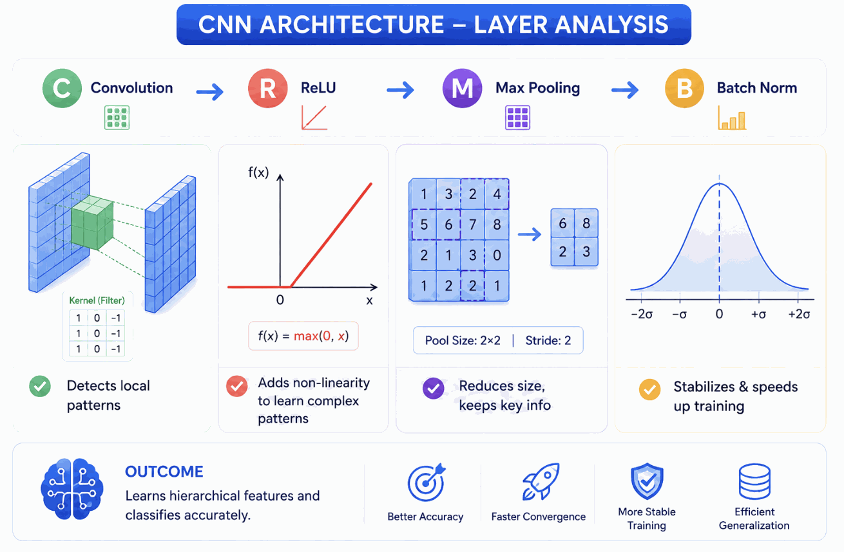
Model Selection And Basics

Slide 10
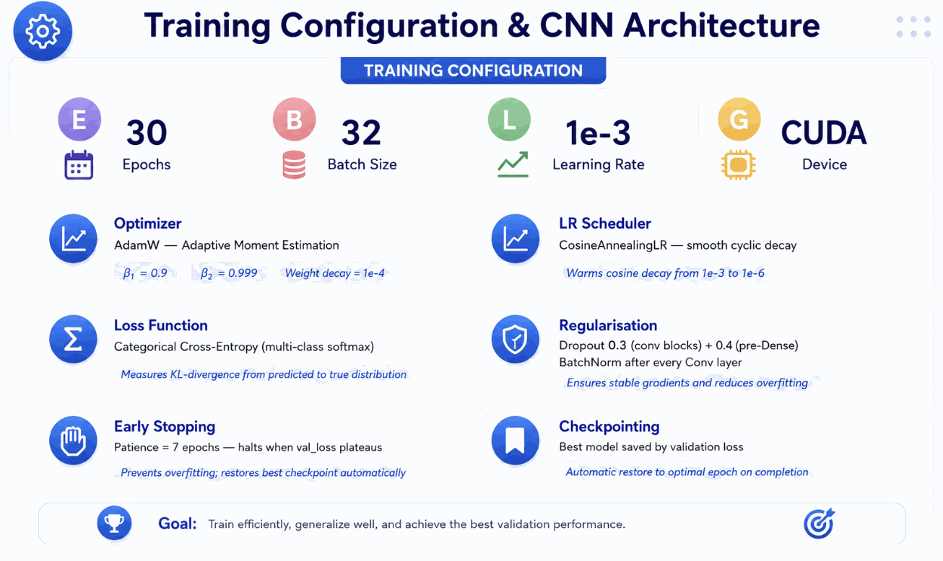
Model Selection And Basics

Slide 11
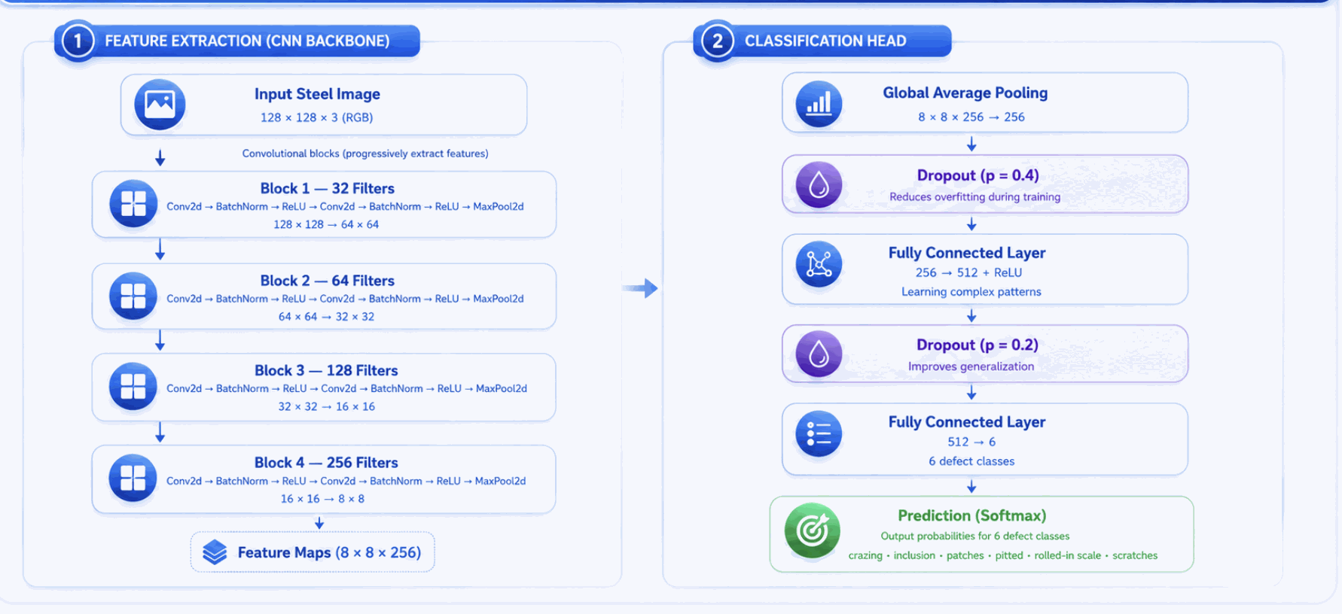
Model Training

Slide 12
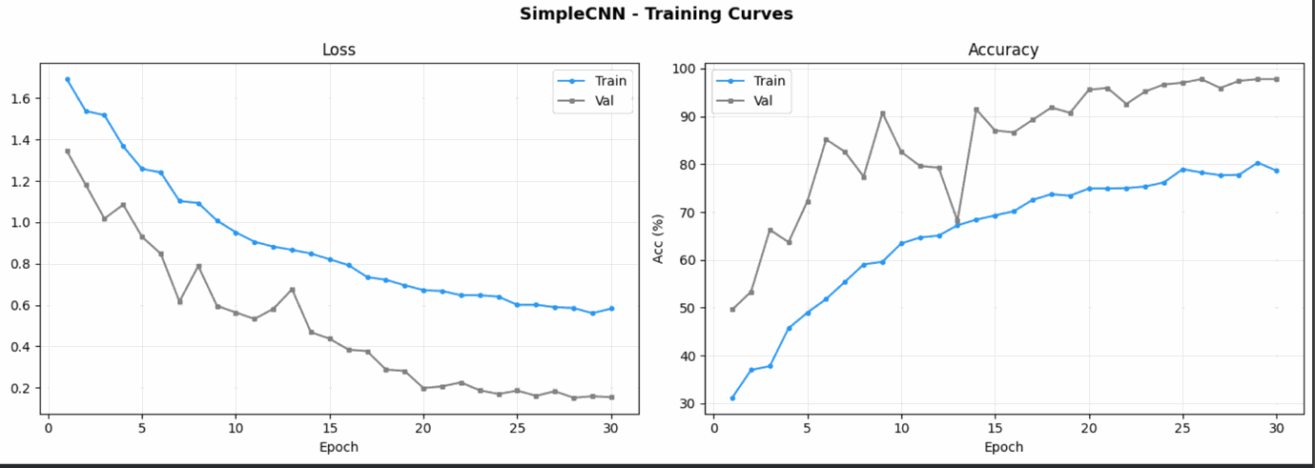
Training Curves

Slide 13
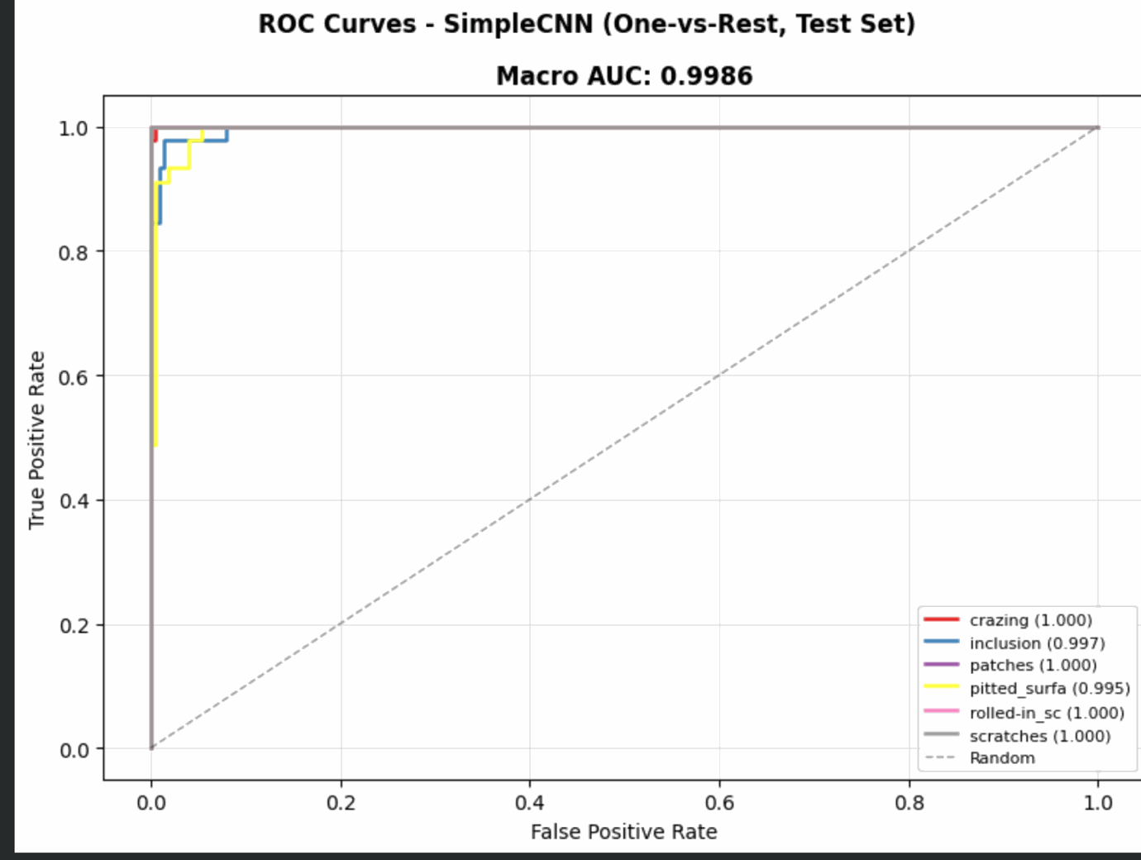
ROC Curves
X axis:- False Positive Rate
Y axis:- True Positive Rate

Slide 14
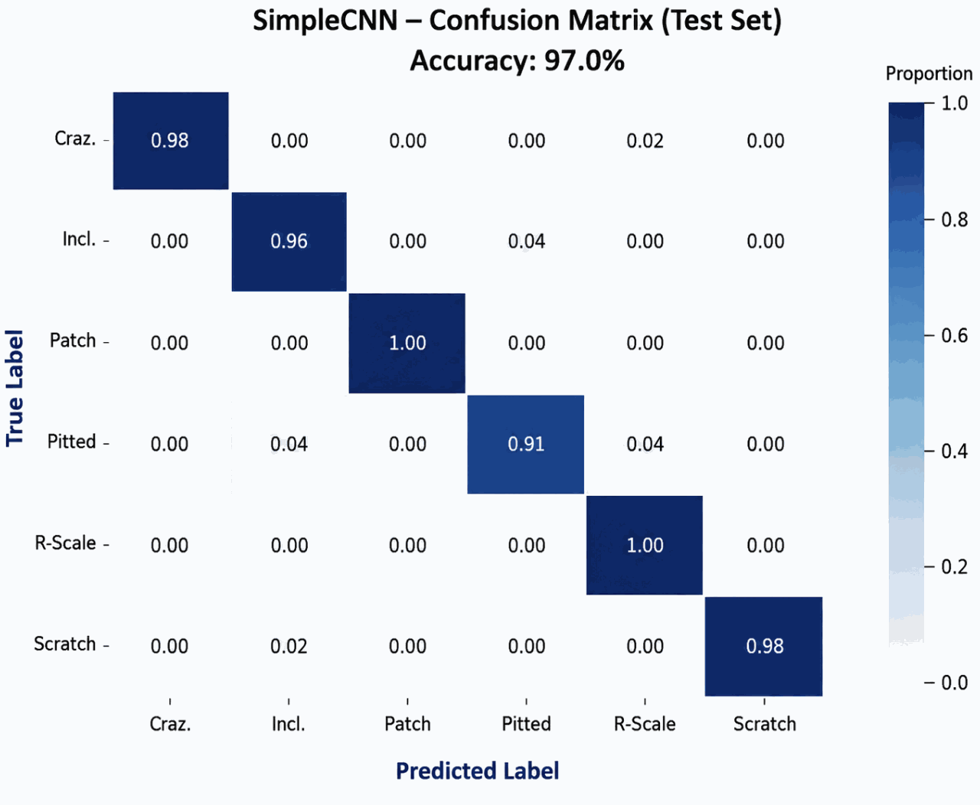
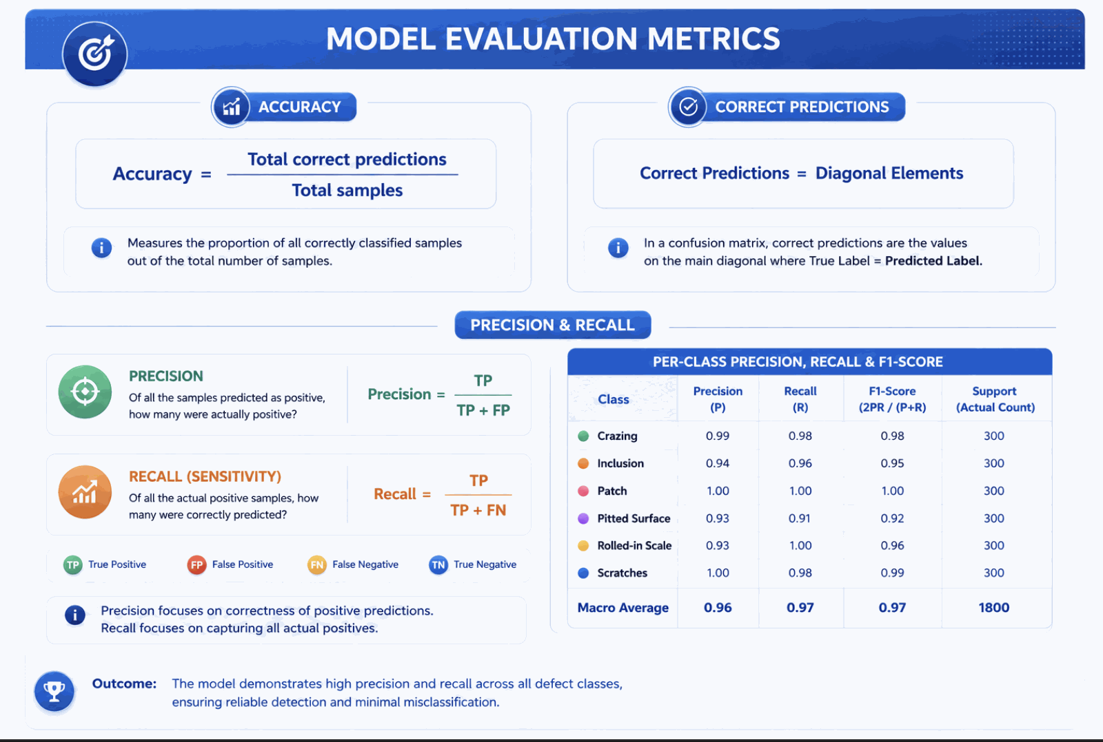
Confusion Matrix
Correct Predictions = Diagonal Elements

Slide 15
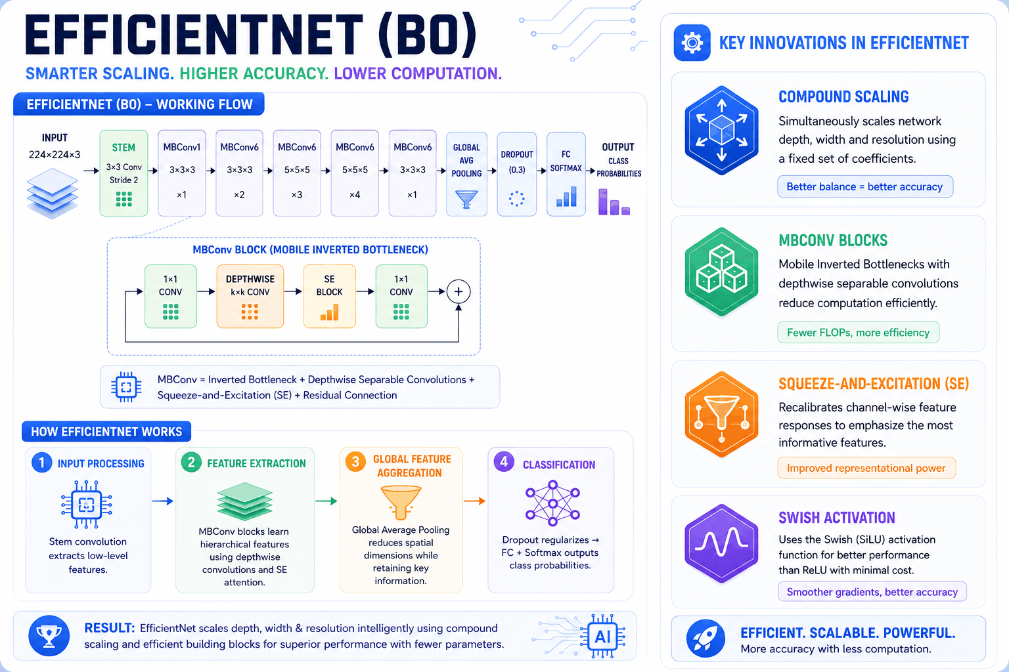

Slide 16


Slide 17
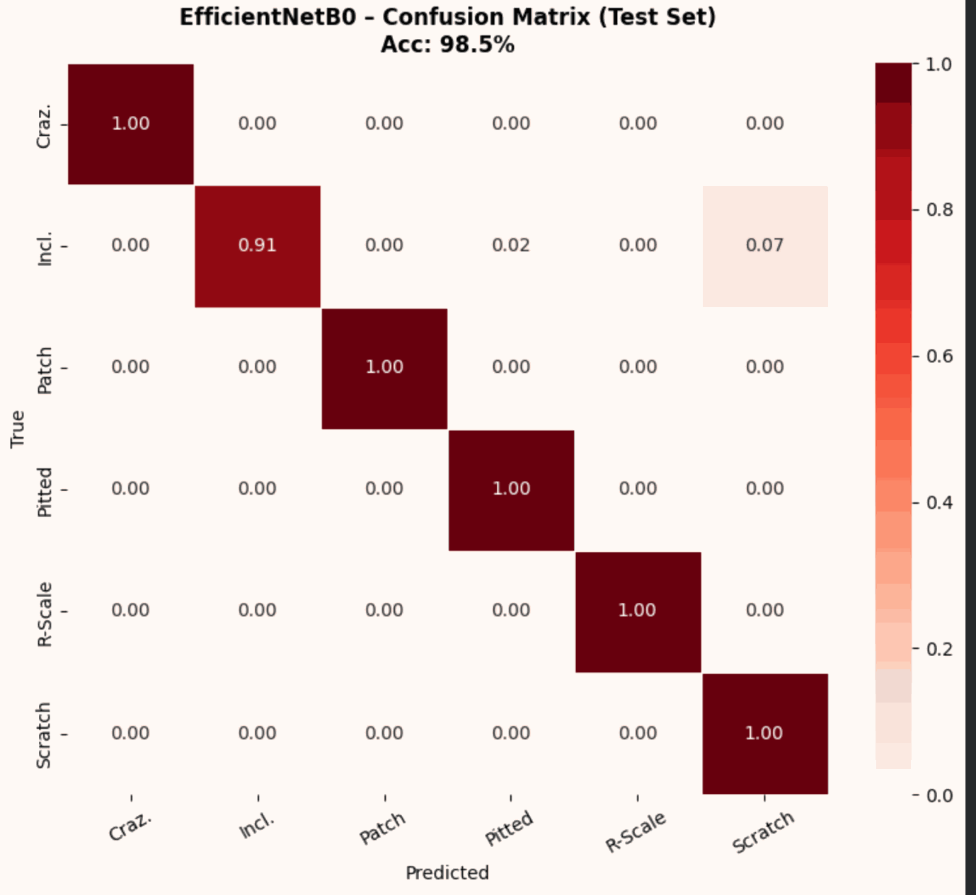
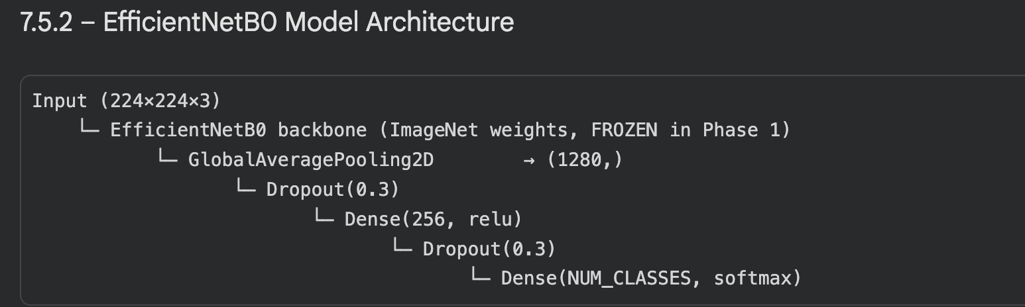
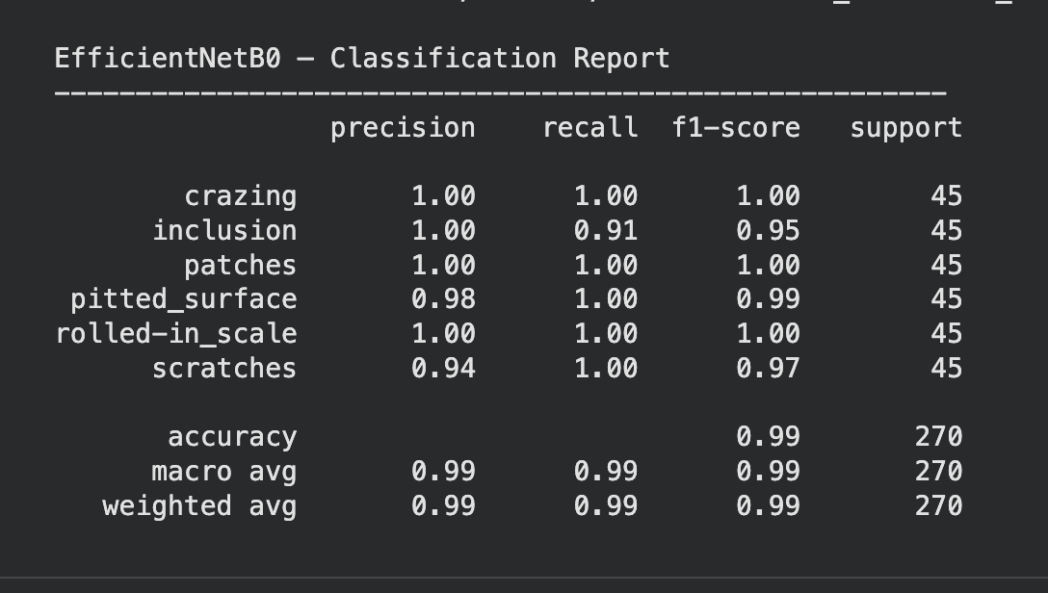
Confusion Matrix
Correct Predictions = Diagonal Elements

Slide 18
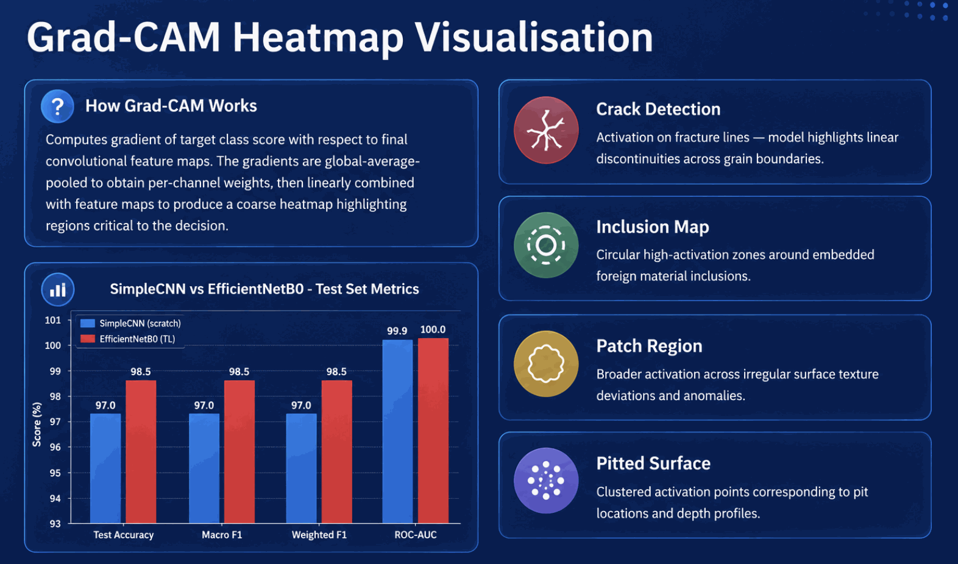

Slide 19
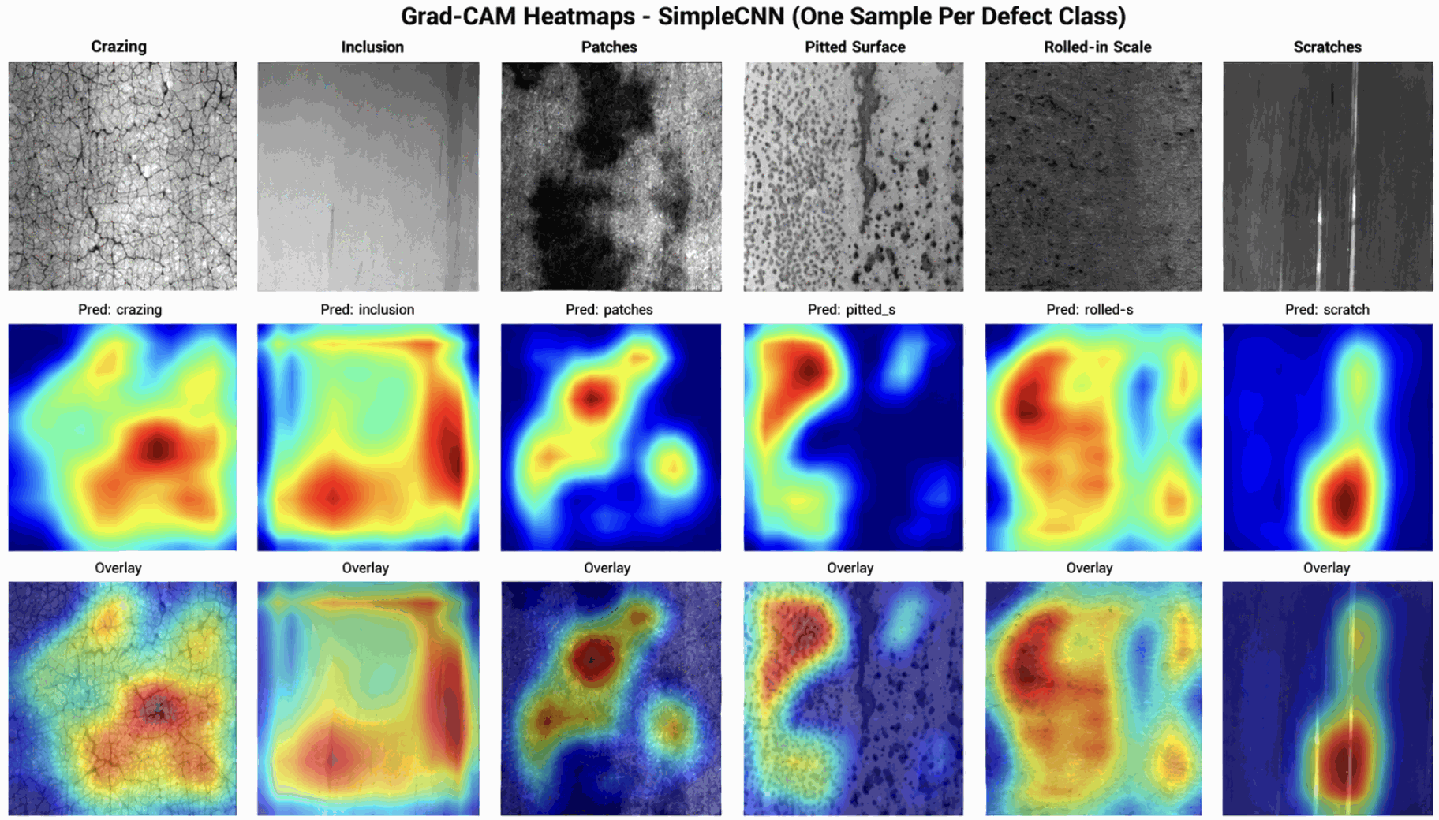
GradCam Results

Slide 20
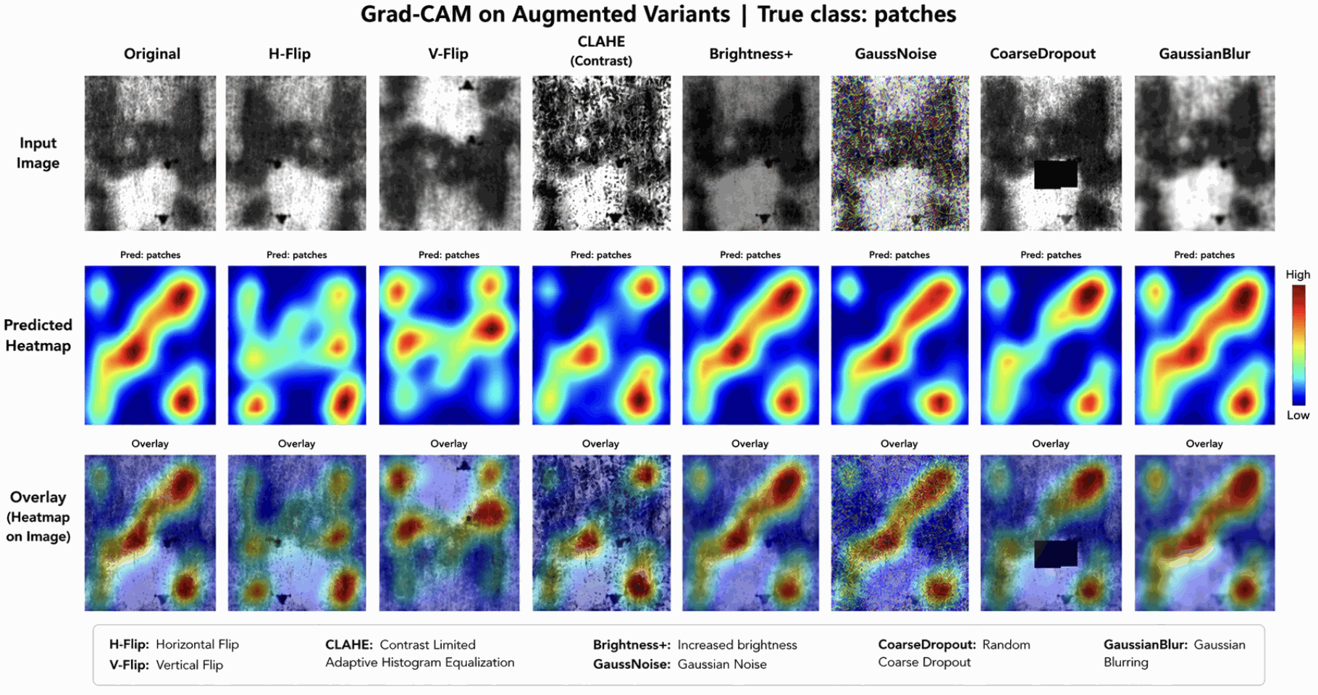

Slide 21
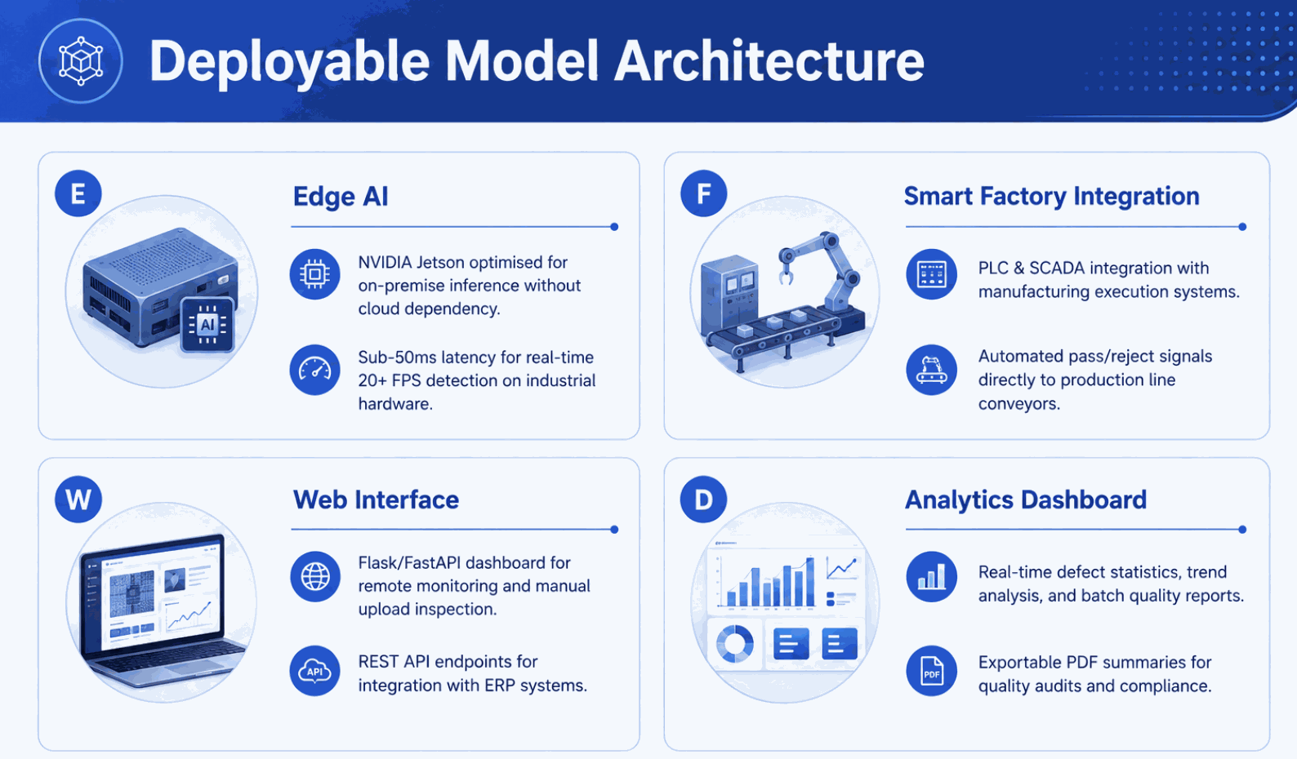

Slide 22
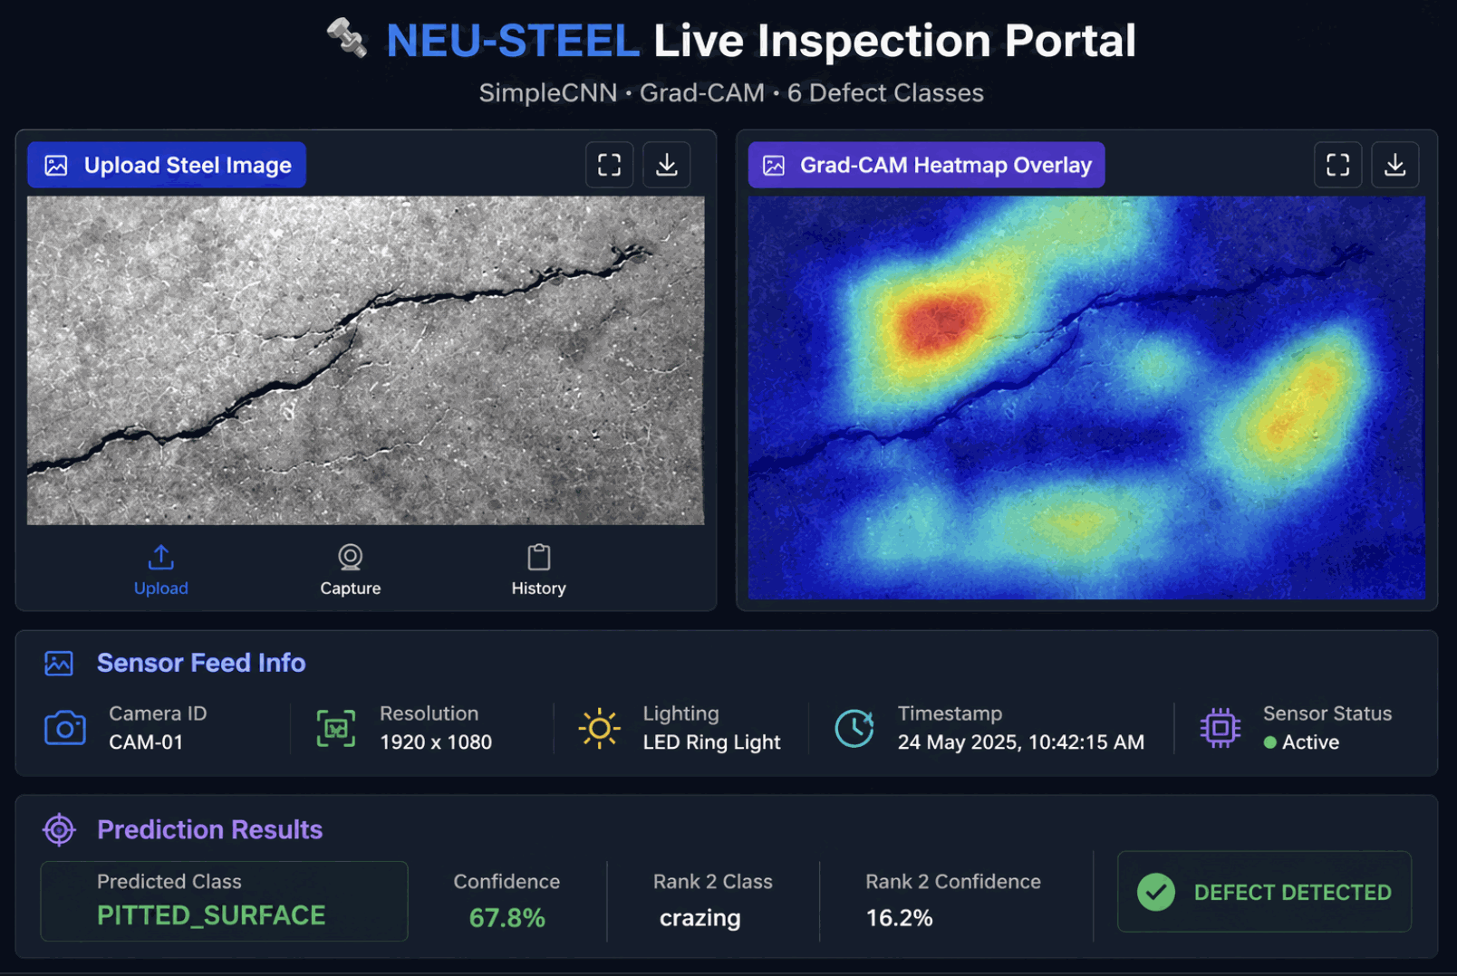
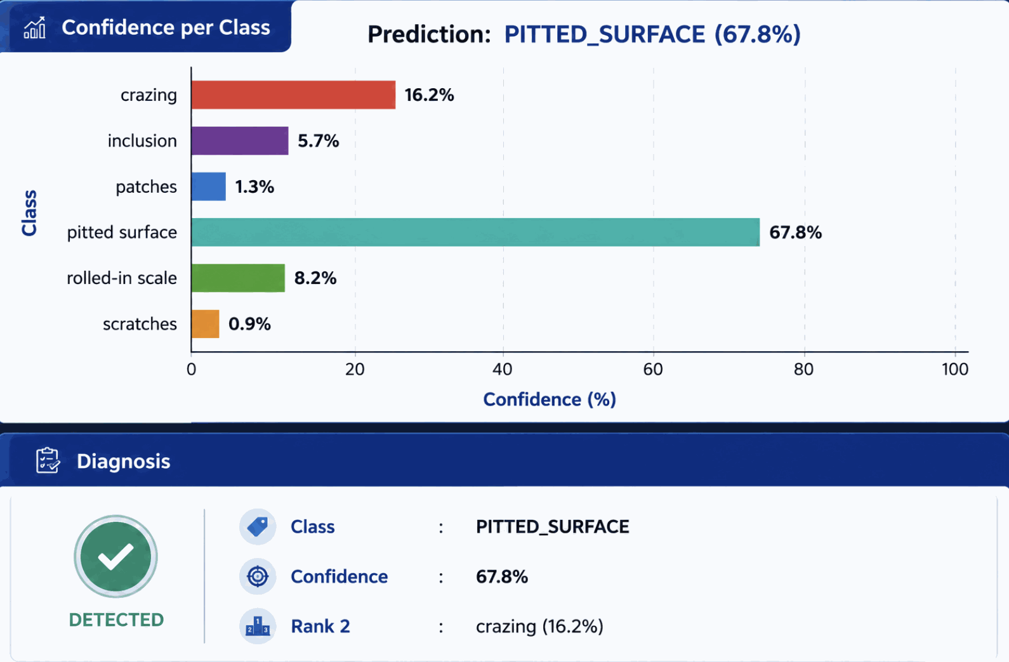
Real-Time Steel Inspection

Slide 23
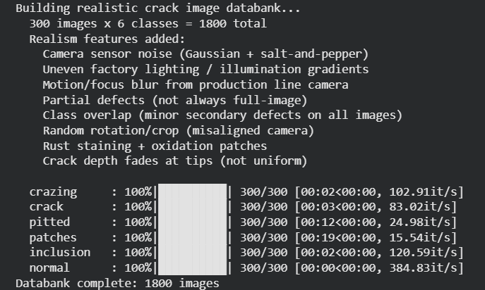
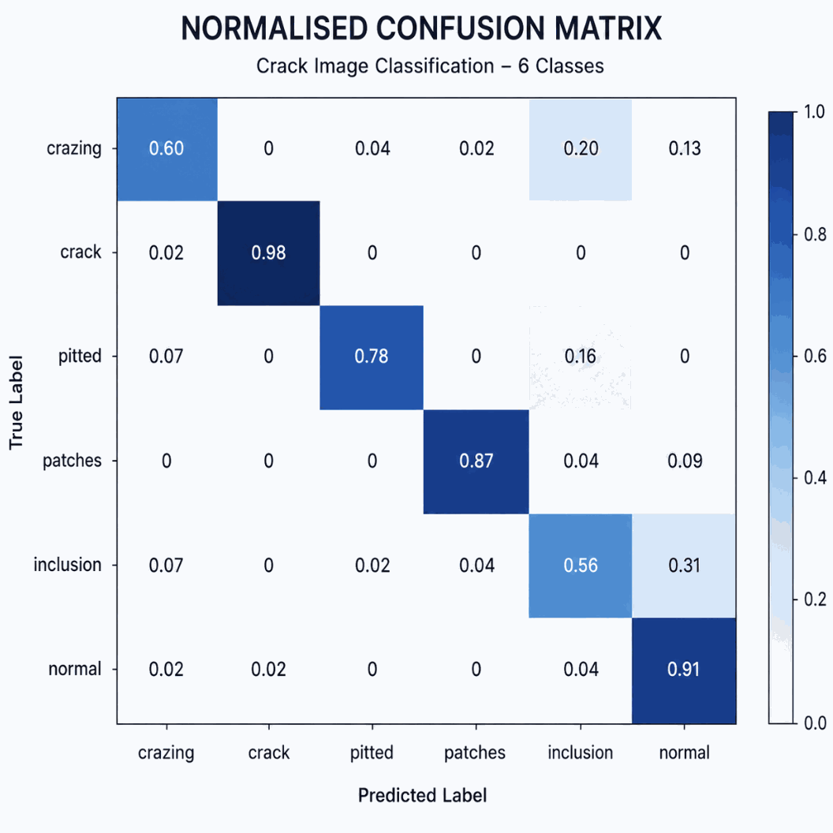
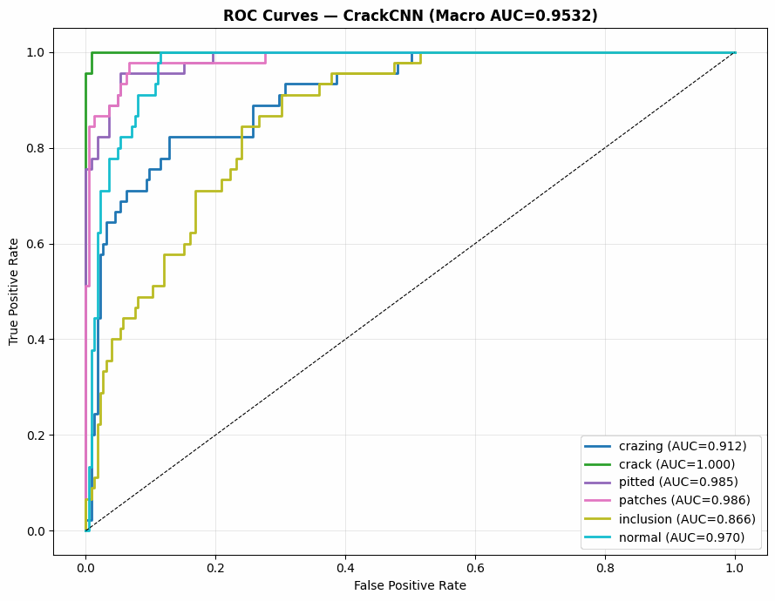
Using Synthetic Dataset

Slide 24
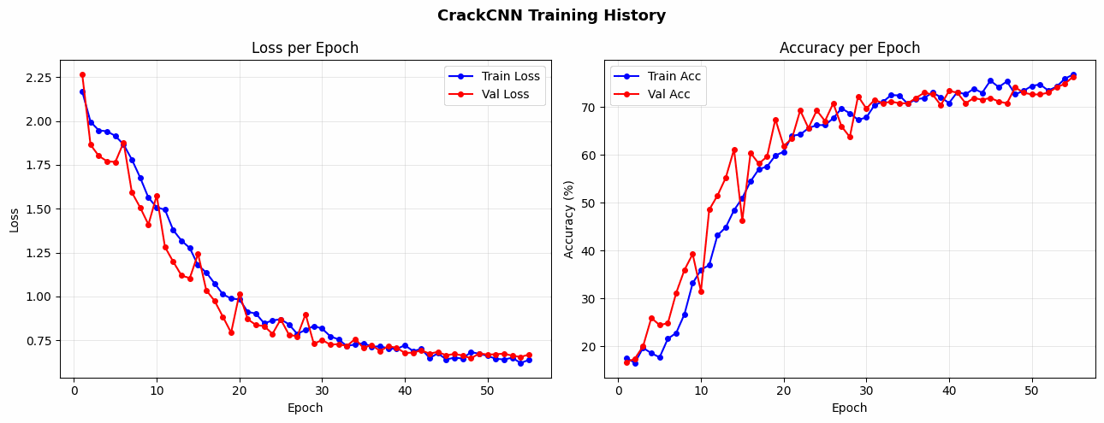


Slide 25
Thank You

